Slide 1
Google Search Result Analysis
Presented By
Rajat Belgundi (PC08)
Kartik Bhutda(PC09)
Amey Bhide(PC14)
Divyang Bagla(PC33)
Guided By
Prof. Nitin Pise

Slide 2
Introduction
Google search results are very efficient and provides relevant web pages based on the keyword searches to its users in a matter of seconds.
Here, we try to find insights about how google ranks various web sites based on different characteristics such as number of searches, content type, content length, etc on 3 very popular domains - wikipedia, fandom and quora and use tableau as a visualization tool to help with the purpose.
We used mongoDB as our database to store the data and pymongo to show how queries can be performed in it based on the requirement of the user.

Slide 3
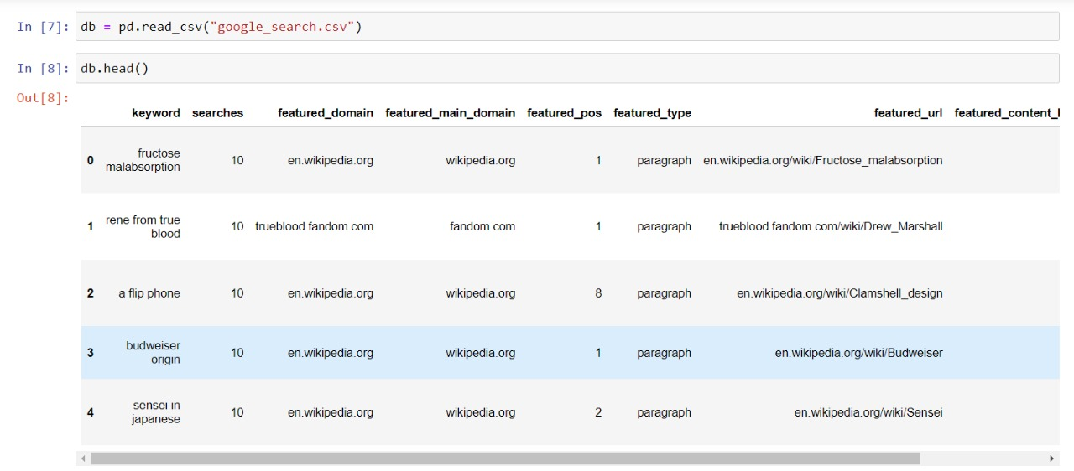
Dataset Used

Slide 4
Dataset
The dataset link is available on:- https://zenodo.org/record/3541092#.YVRV_ZpBxPZ
Dataset contains the following elements:
keyword,
number of monthly searches,
featured domain,
featured main domain,
featured position,
featured type,
featured url,
content,
content length.

Slide 5
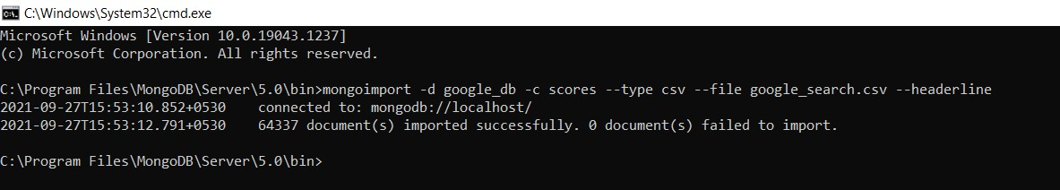
Storing CSV file data in MongoDB
Instead of manually inserting the data in mongoDB, or converting the csv file into json and then storing into MongoDB, we can run the above command and directly save the data in csv file into MongoDB

Slide 6
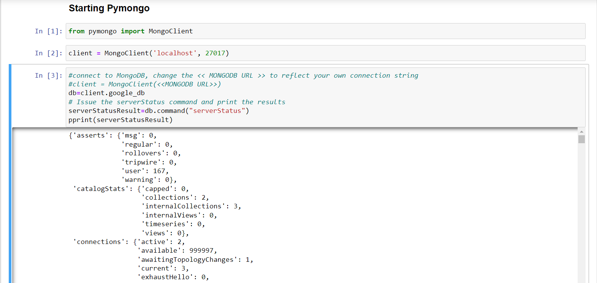
PyMongo Connection

Slide 7
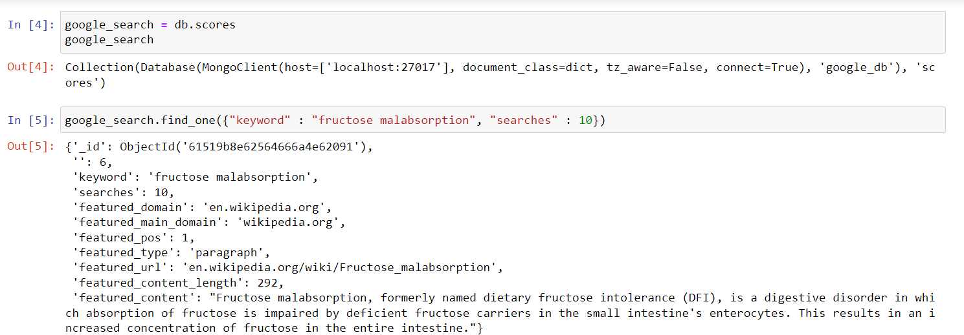
Get Element By Keyword: find_one (create)

Slide 8
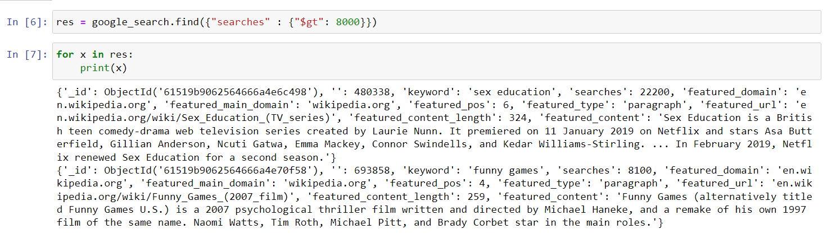
Get Elements with conditions

Slide 9
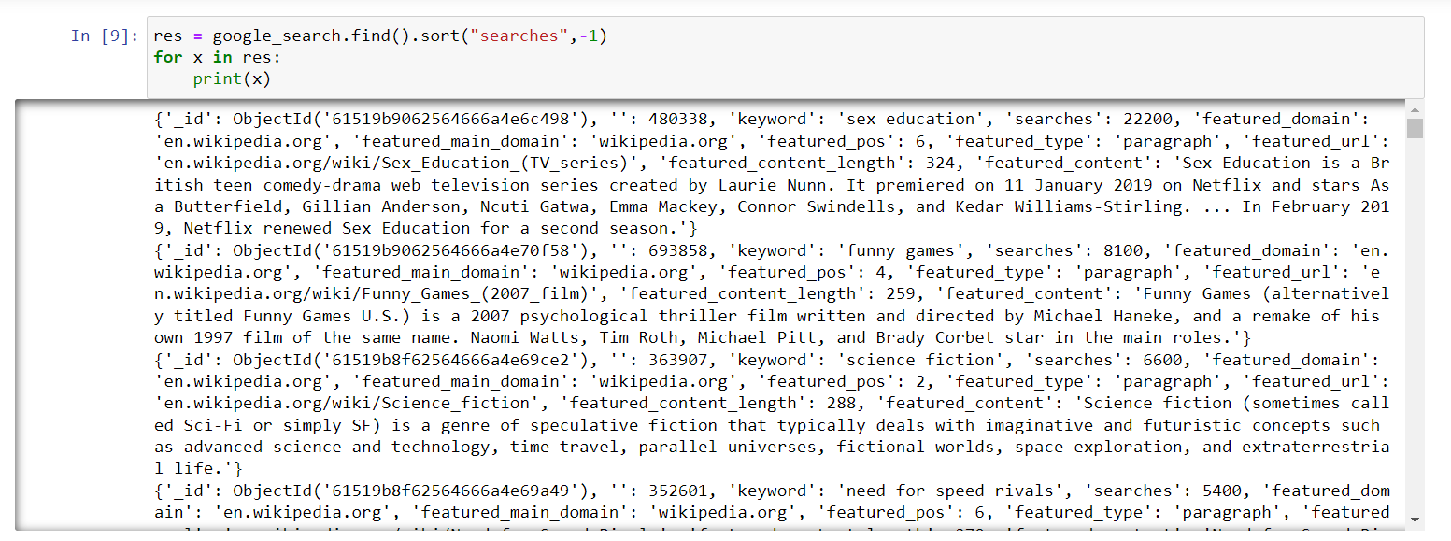
Sort Elements by Ascending and Descending order

Slide 10
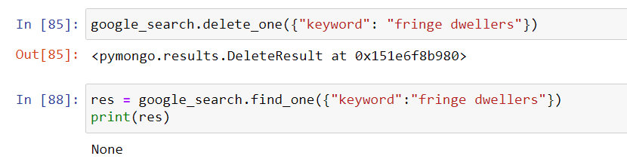
CRUD operations

Slide 11
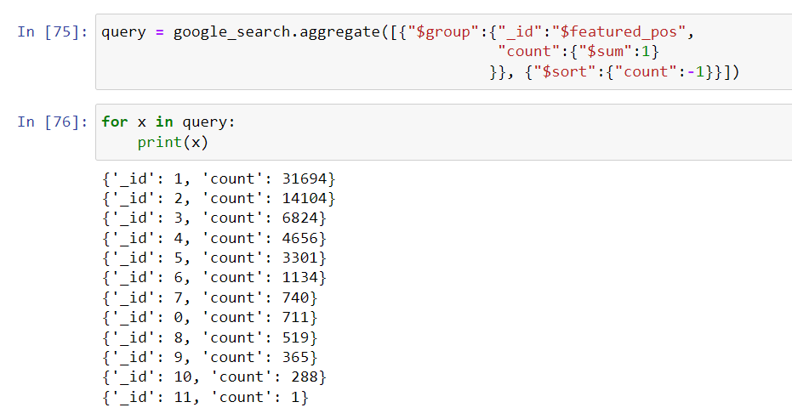
Group by featured_pos and then sort by count
Aggregation

Slide 12
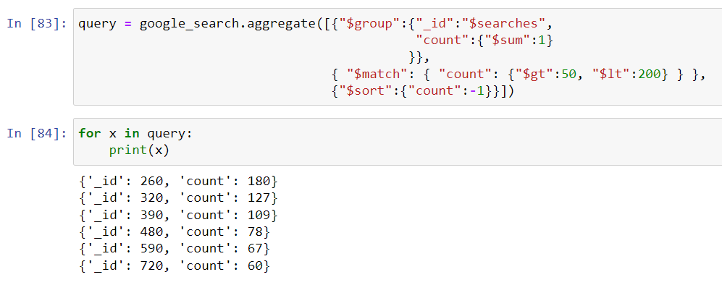
Aggregation
Group by searches and get elements whose searches are greater than 50 and less than 200

Slide 13
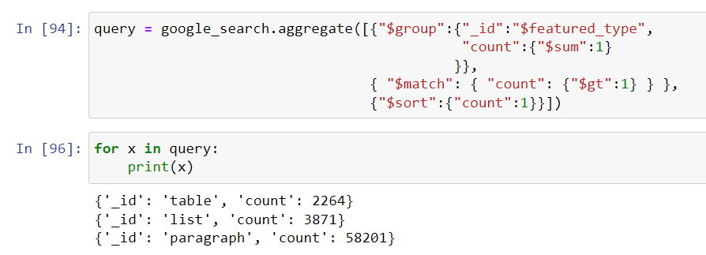
Group by featured_type and get results whose count is greater than 1
Aggregation

Slide 14
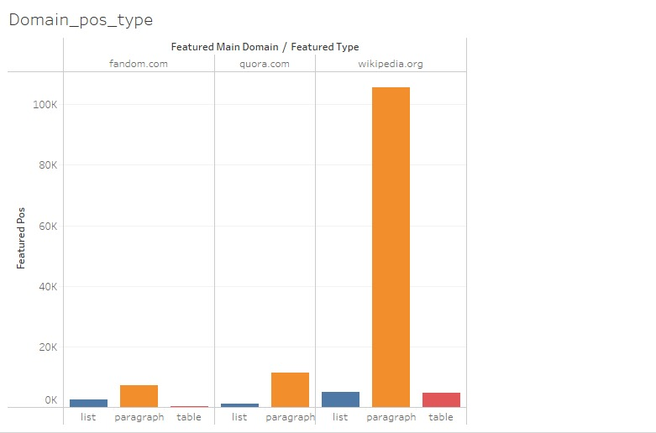
TABLEAU Visualizations

Slide 15
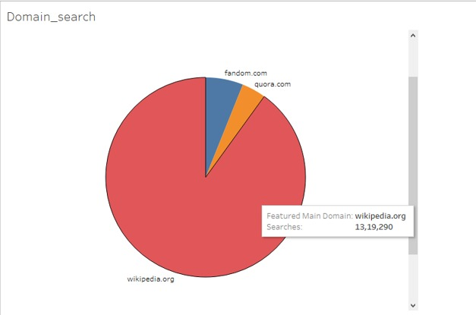

Slide 16
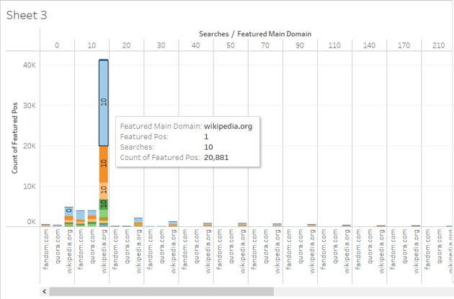

Slide 17
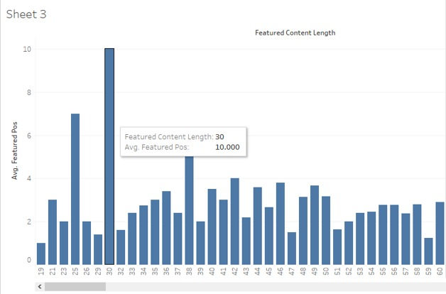

Slide 18
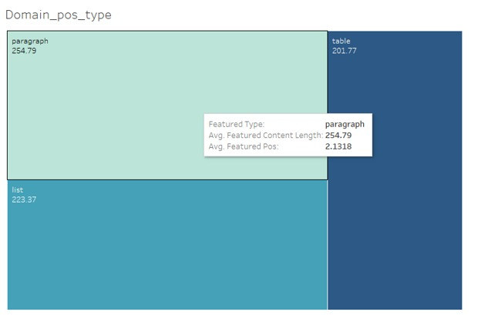

Slide 19
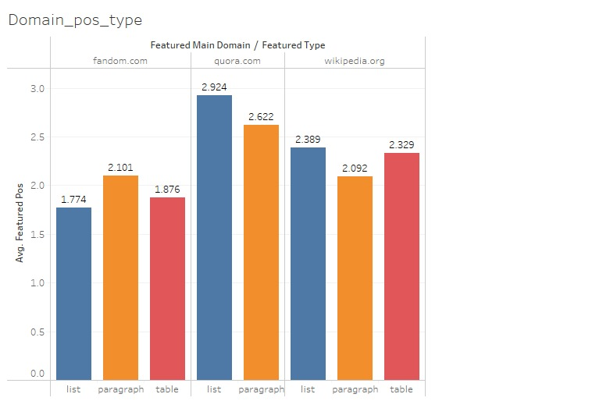

Slide 20
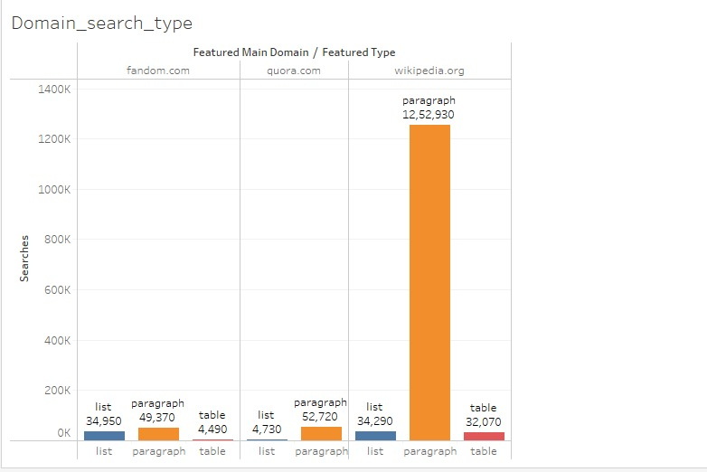

Slide 21
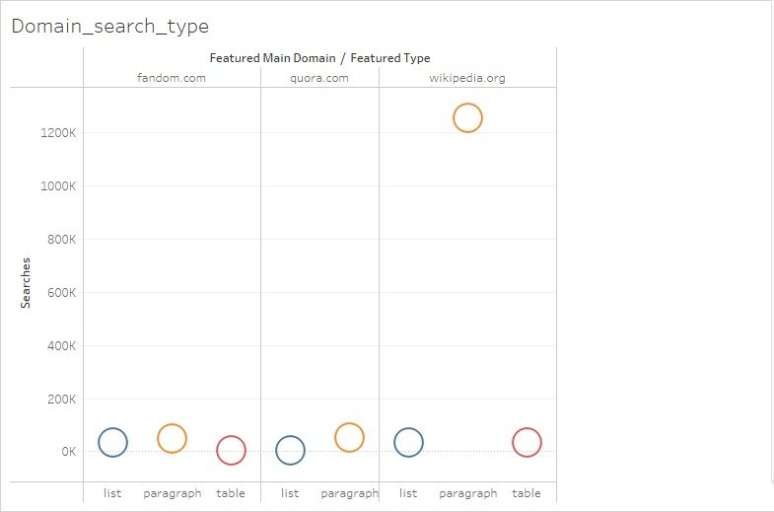

Slide 22
Conclusion
MongoDB is a great tool to handle large datasets and performing complex queries on them. With pymongo you can run MongoDB queries in a python environment and retrieve data in a dictionary format for further processing in the environment itself.
Following things can be concluded after visualization:-
Wikipedia is the most searched domain followed by fandom and quora.
Most of the content is of type paragraph in all 3 sites.
Sites having around 10 searches have most of their featured position in 1st rank on google however interestingly, sites having more than 10000 searches do not have their featured position as 1 rather they are placed at 4/6th position.
Sites having content length more than 200 are more likely to ranked higher than other sites.

